Slide 1
POWERSHELL + MSAL
(Almost) Everything you need to know about authenticating to Azure.

Slide 2



Ben Reader
Ben Whitmore
Code monkey, Patch My PC
Handsome guy (20yrs ago), Patch My PC
@powers_hell
@byteben

Slide 3
Death by slides
(a joke by B1)

Slide 4
Summary time
Authentication seems hard… Why?
What tools exist to make authentication… not seem hard?
Authentication + MFA
What the hell is an auth token?
HELP! My device doesn’t have a keyboard (Device Code Authentication)
Passwords are stupid – or how to learn to love client secrets…
Client secrets are stupid – stop being scared of certificates…
Credentials are stupid – just use managed identities!
Extra credit?????

Slide 5
Basic authentication.
(raw dogging the internet)

Slide 6
Pre-Reqs to make our lives better
VS Code // Windows Terminal.
PowerShell 5 ( or PowerShell 7 if you are cool – YOU ARE COOL).
MSAL.PS
“Install-Module MSAL.PS”
https://www.powershellgallery.com/packages/MSAL.PS
THAT’S IT.

Slide 7
Interactive authentication.
Getting an auth token the MSAL.PS way.

Slide 8
Device code authentication.
Or how to authenticate to Graph on your TV…?

Slide 9
Non-Interactive Authentication.
Stop being paid to do busy work and make computers work for you… or something…

Slide 10
Certificate based authentication.
You left your client secret in your source code… didn’t you?

Slide 11
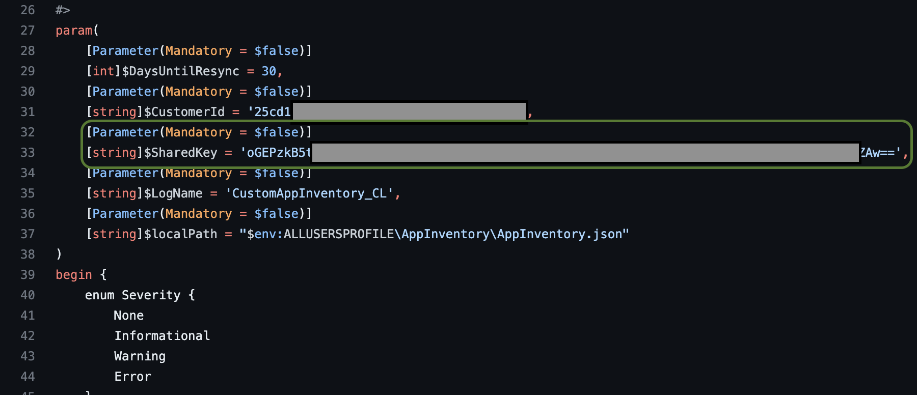
Does this look familiar?

Slide 12
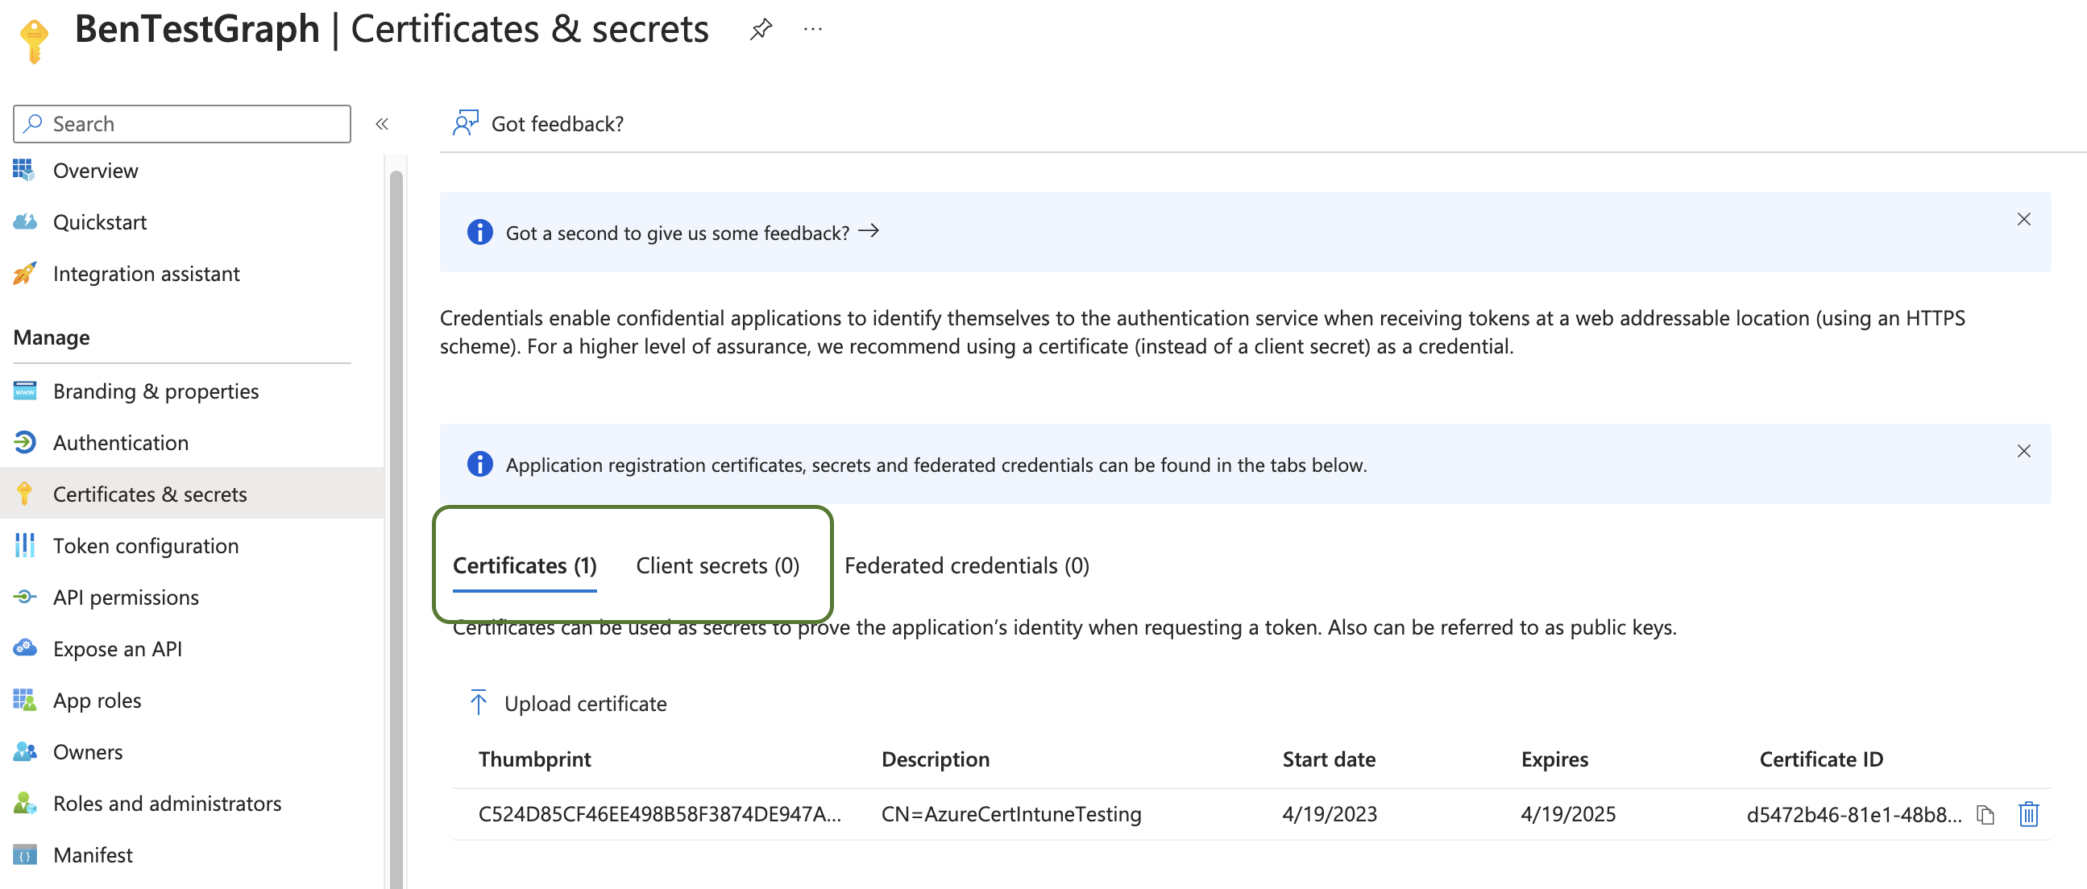
A better way

Slide 13
Create a certificate
$subjectName = "AzureCertIntuneTesting"
$certStore = "LocalMachine"
$validityPeriod = 24
$newCert = @{
Subject = "CN=$($subjectName)"
CertStoreLocation = "Cert:\$($certStore)\My"
KeyExportPolicy = "Exportable"
KeySpec = "Signature"
NotAfter = (Get-Date).AddMonths($($validityPeriod))
}
$Cert = New-SelfSignedCertificate @newCert

Slide 14
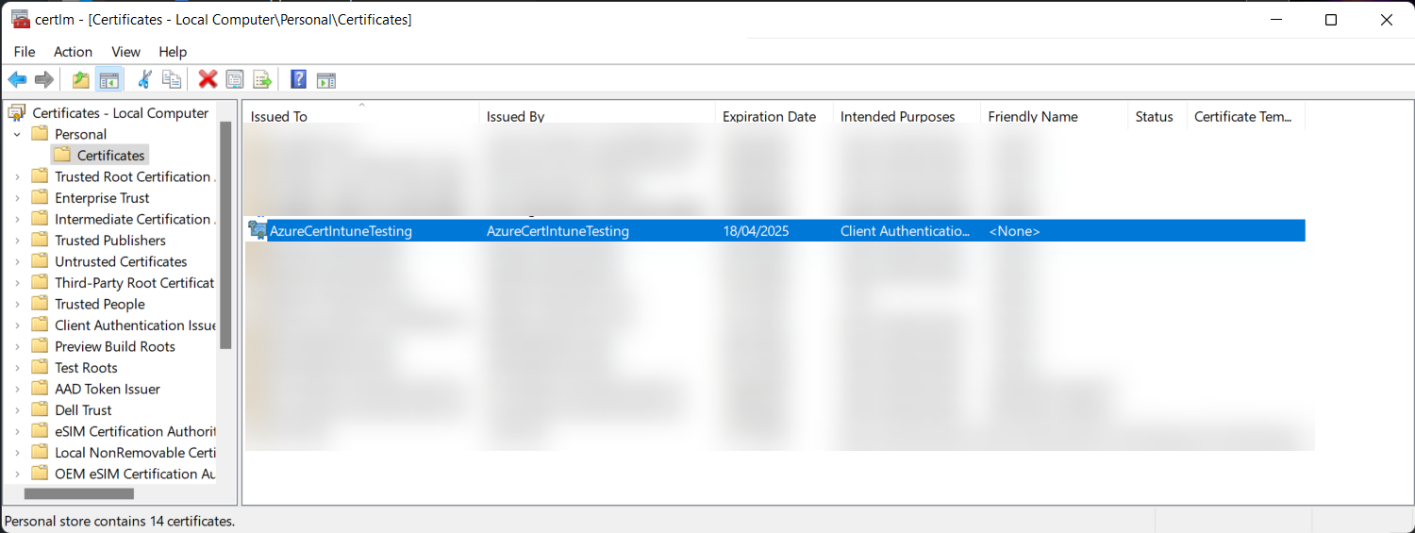
Create a certificate

Slide 15
Export the public key
$certFolder = "C:\temp\certs"
$certExport = @{
Cert = $Cert
FilePath = "$($certFolder)\$($subjectName).cer"
}
Export-Certificate @certExport

Slide 16
Export the private key (danger)
$certFolder = "C:\temp\certs"
$certThumbprint = $Cert.Thumbprint
$certPassword = Read-Host -Prompt "Enter password for your certificate: " -AsSecureString
$pfxExport = @{
Cert = "Cert:\$($certStore)\My\$($certThumbprint)"
FilePath = "$($certFolder)\$($subjectName).pfx"
ChainOption = "EndEntityCertOnly"
NoProperties = $null
Password = $certPassword
}
Export-PfxCertificate @pfxExport

Slide 17
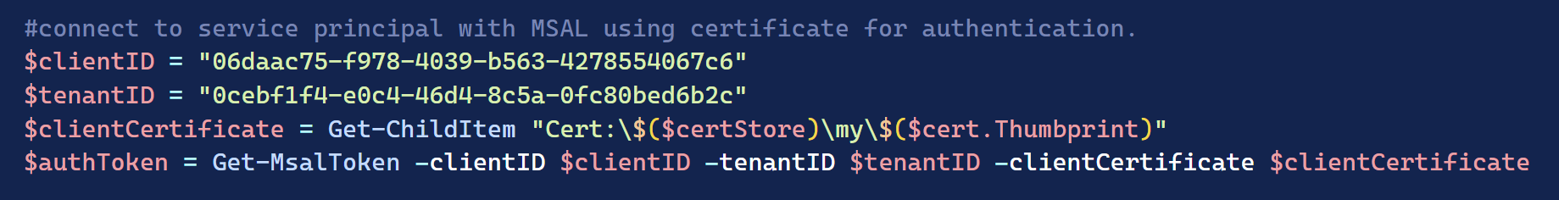
Connect with the Certificate
Upload public portion to the app registration

Slide 18
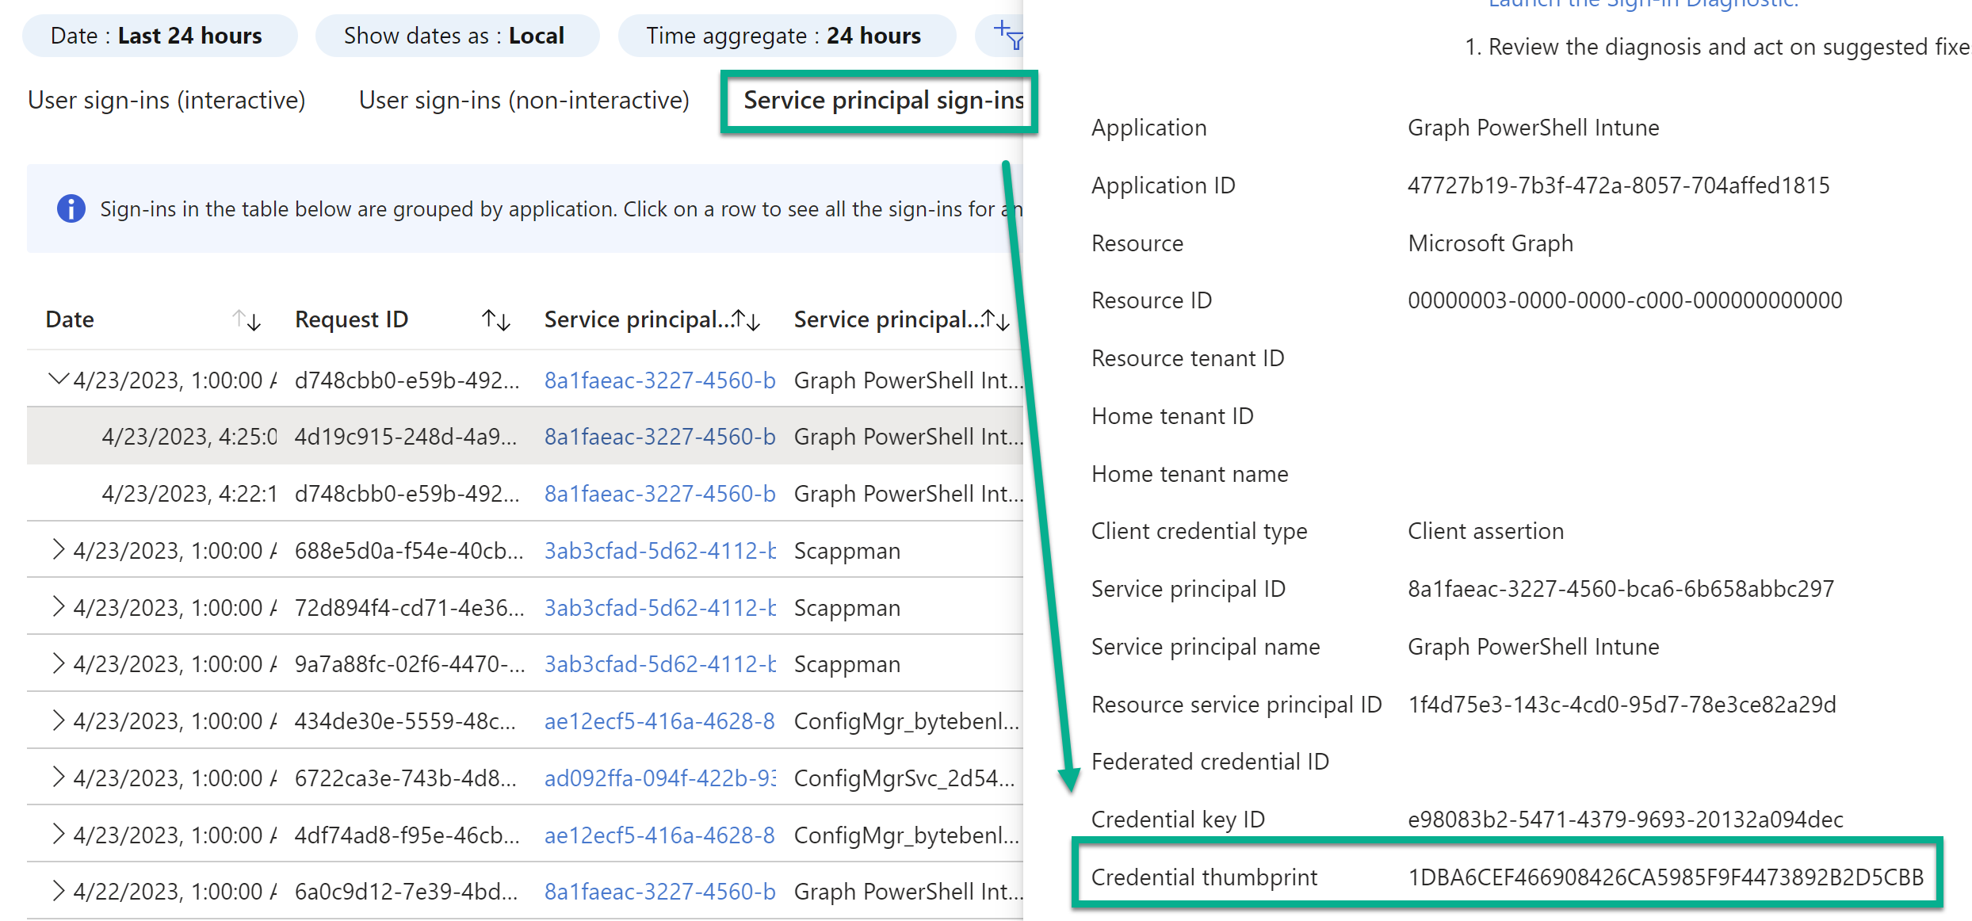
Connect with the Certificate

Slide 19
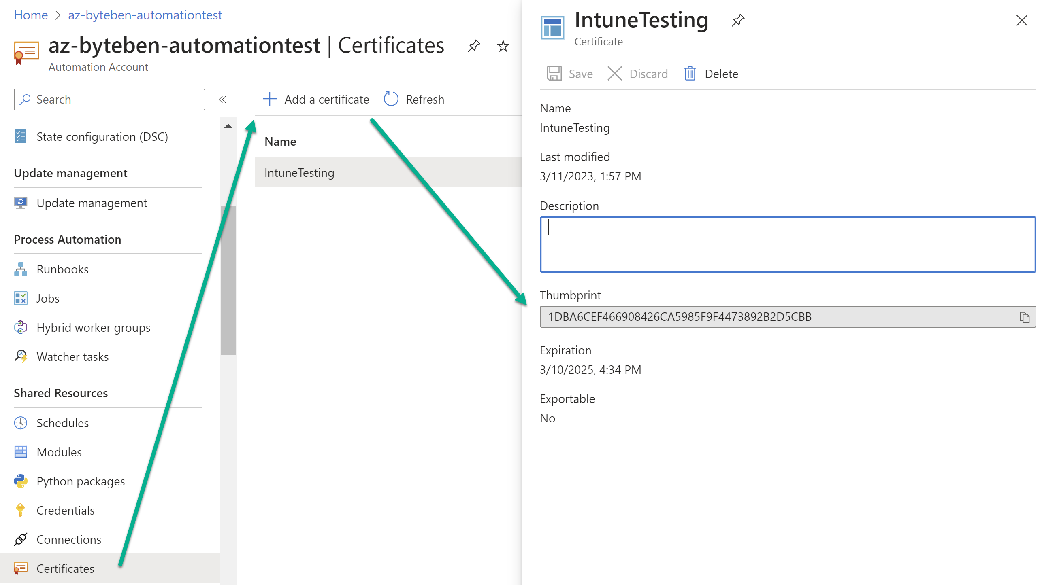
Certificate with Azure Automation

Slide 20
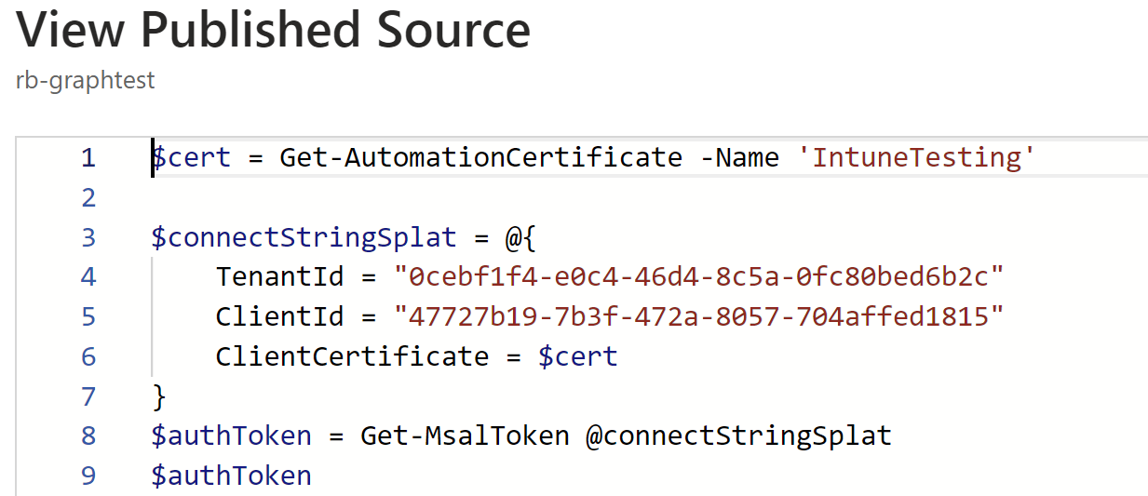
Certificate with Azure Automation

Slide 21
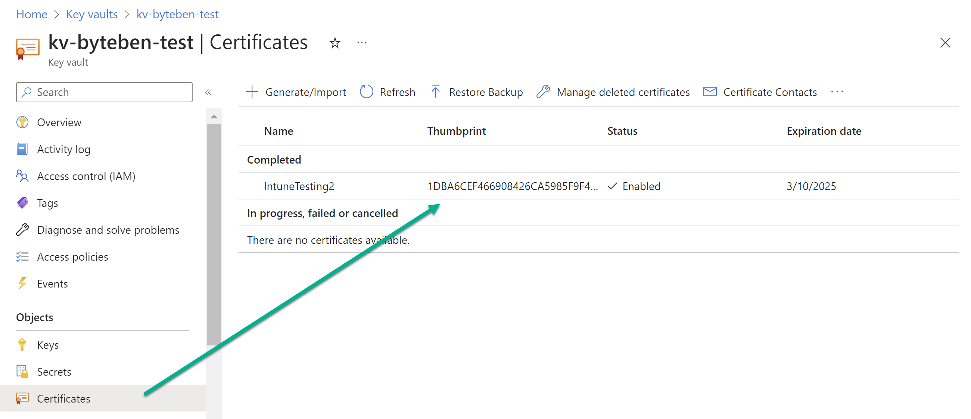
Certificate with Azure Automation & Key Vault

Slide 22
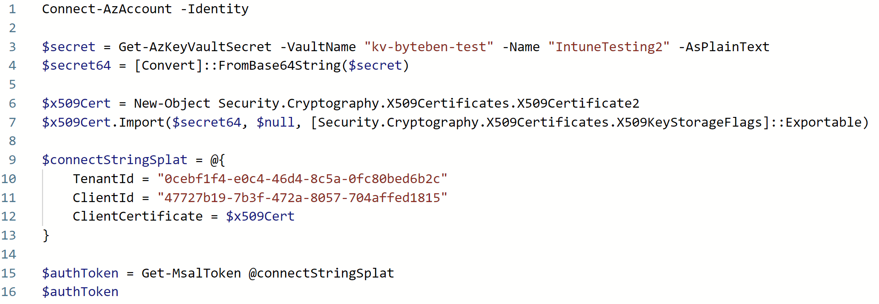
Certificate with Azure Automation & Key Vault

Slide 23
Managed identities and authentication.
Galaxy brain time.

Slide 24
Showing off with MSAL.PS.
Make your colleagues hate you by being smarter than them.

Slide 25
Summary
Authentication isn’t really that hard.
You are already using MFA – so we don’t need to remind you about that.
Certificates aren’t scary – use them for production workloads.
Managed Identities are cool – if you can, use them.
PowerShell makes all of this comically simple – learn it, love it, use it all the time.

